Slide 1
Assignment 2C Presentation EECE 443 Team 2: MCU TNC Design Kaleb Leon – C00094357 Kobe Keopraseuth – C00092349 David Cain – C00043561 April 2nd, 2020

Slide 2
MCU TNC Assignment 2C
David Cain, Kobe Keopraseuth, and Kaleb Leon

Slide 3
Adjustments
Added Safety requirements to Preliminary Design. Considered specified needs with consideration of public health, safety, and welfare, as well as global, cultural, social, environmental, and economic factors.
Made and Added OSI layered communication model to Appendix D
Made flowchart easier to read as well as fixed some connections
Corrected any Grammatical and Formatting Errors needed

Slide 4
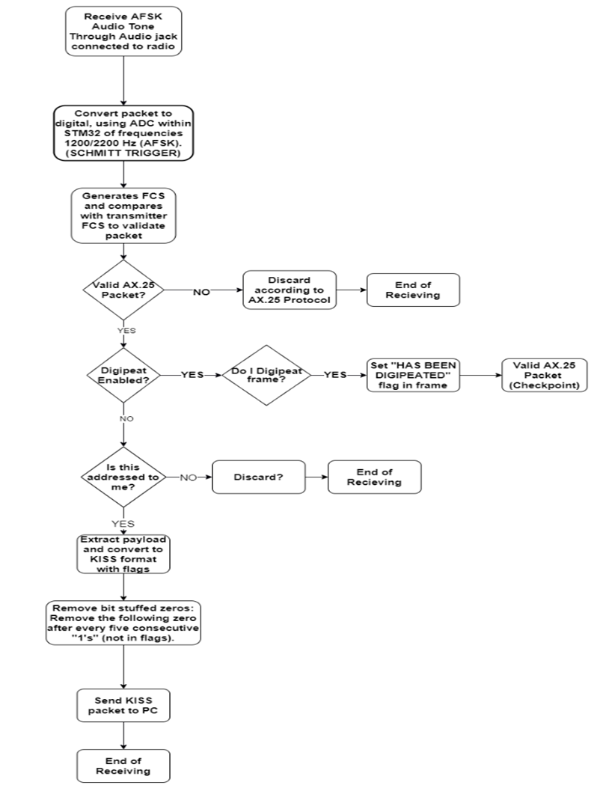
Receiving Flowchart

Slide 5
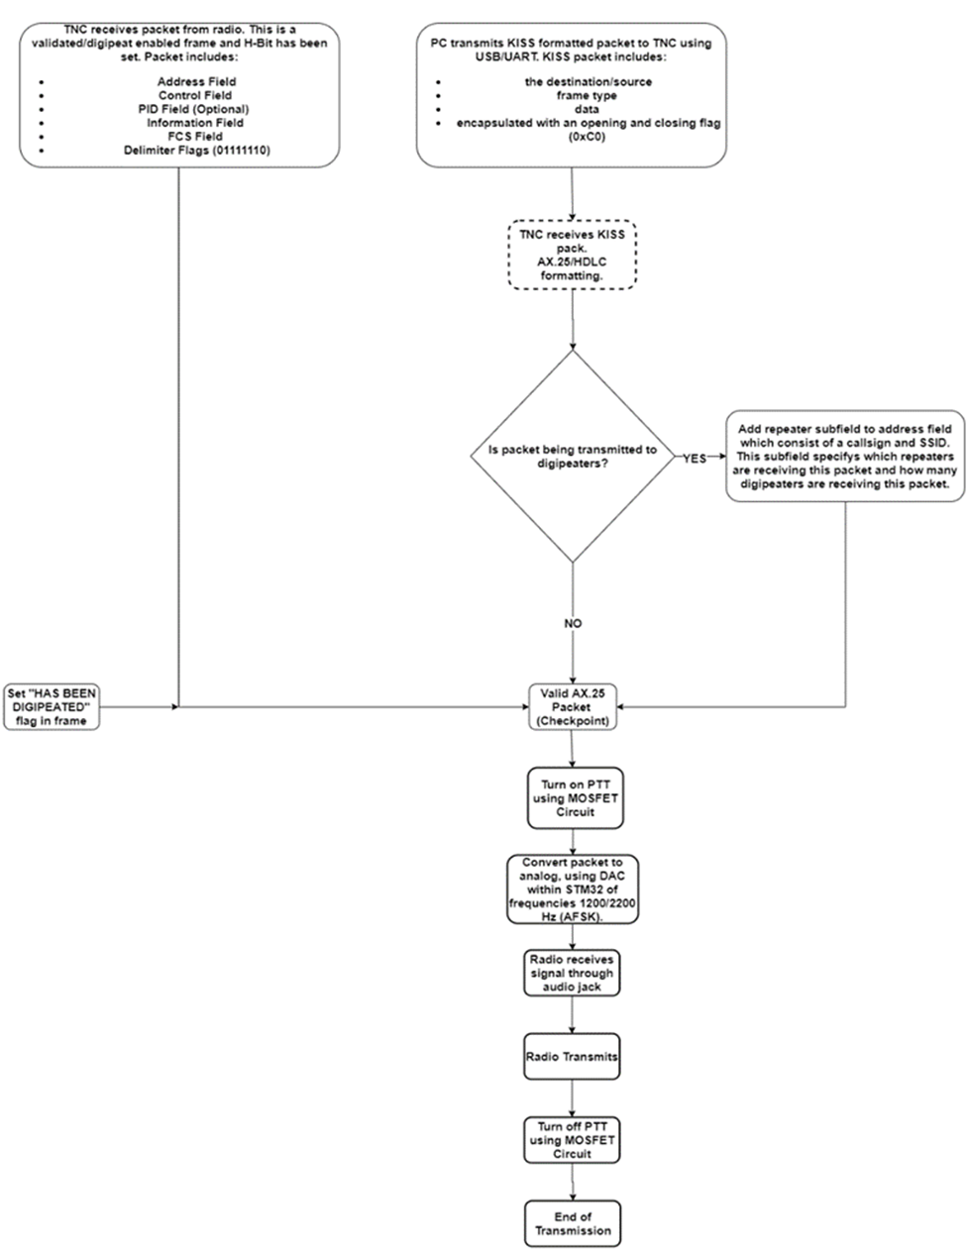
Transmitting Flowchart

Slide 6
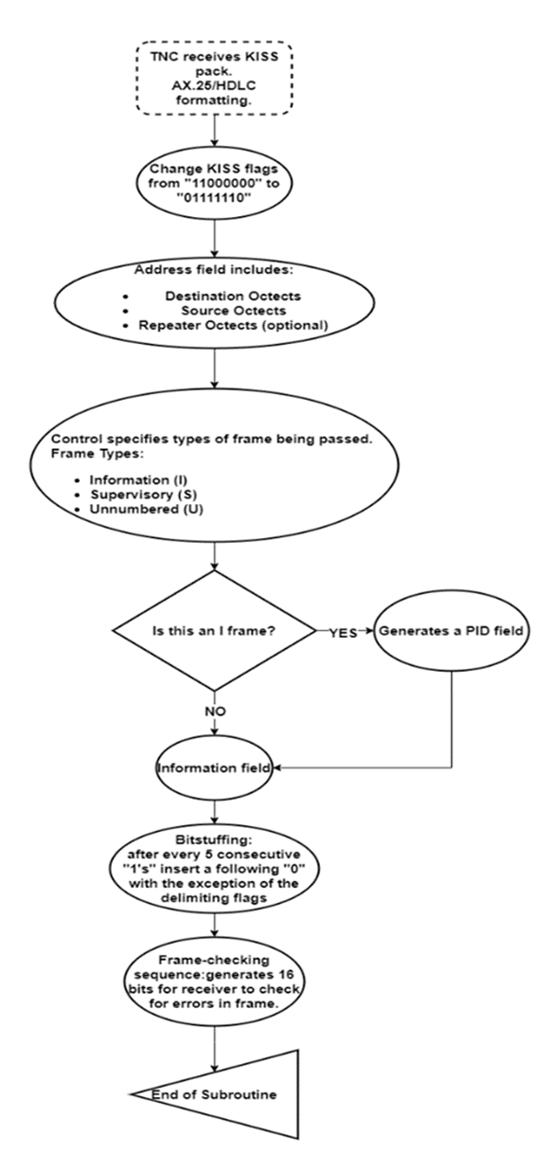
Formatting Flowchart

Slide 7
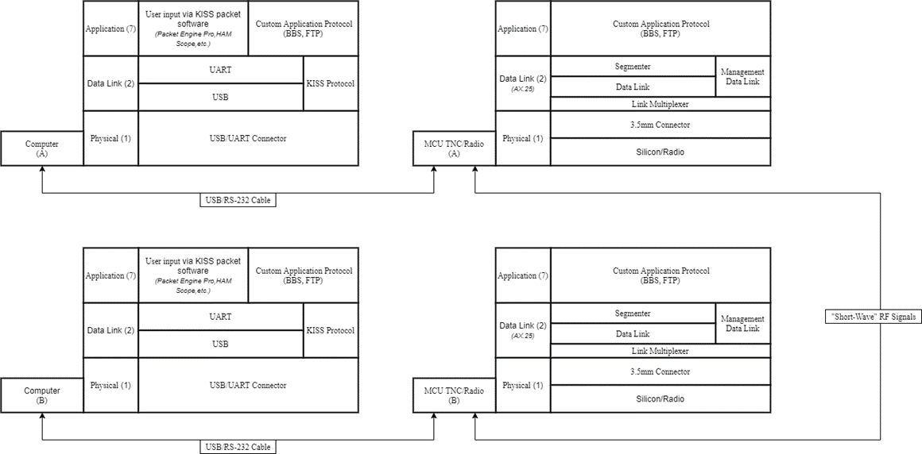
OSI Layer Communications Model

